Slide 1

AN OVERVIEW OF SOME MACHINE LEARNING MODELS
BY RISING ODEGUA

Slide 2
THE “NO FREE LUNCH THEOREM”
The “No Free Lunch” theorem states that no one algorithm works best for every problem
Pick an Algorithm based on true problem.
Pick an Algorithm based on the data set.

Slide 3
SOME SUPERVISED LEARNING ALGORITHMS

Slide 4
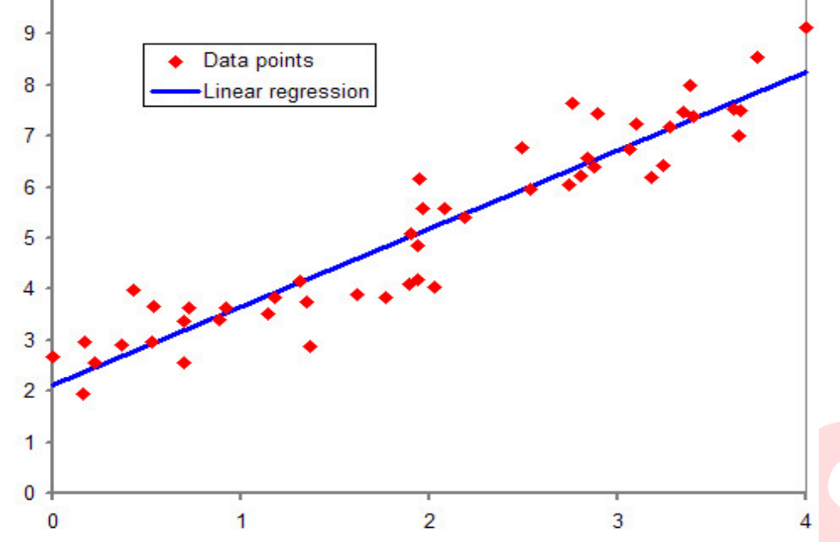
LINEAR REGRESSION
Linear regression simply finds a line that best fits the relationship between the input variables (x) and the output variables (y), by finding specific weightings called coefficients (B).
For example: y= B0 + B1 * x

Slide 5
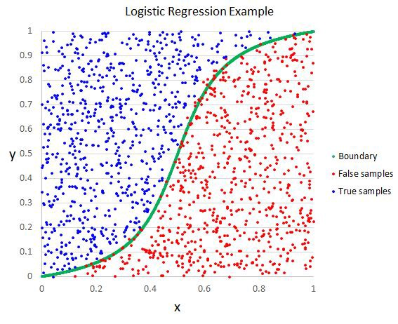
LOGISTIC REGRESSION
It is the go-to method for binary classification problems (problems with two class values)
It separates data into classes.

Slide 6
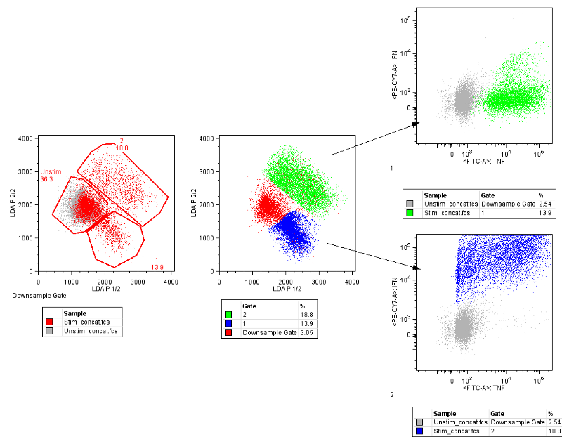
Linear Discriminant Analysis
If you have more than two classes then the Linear Discriminant Analysis can be used.

Slide 7
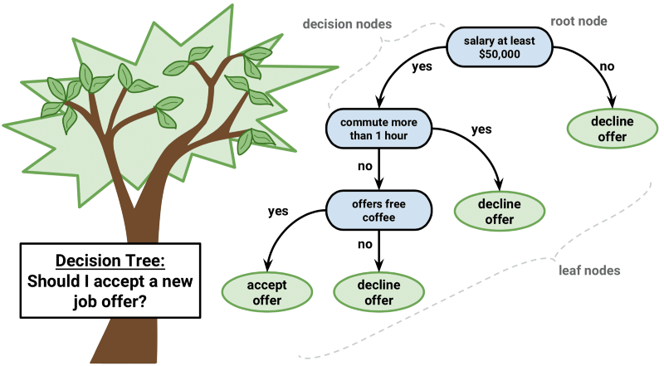
TREE MODELS
Decision Trees can be used for classification and regression problems.
The leaf nodes of the tree contain an output variable (y) which is used to make a prediction

Slide 8
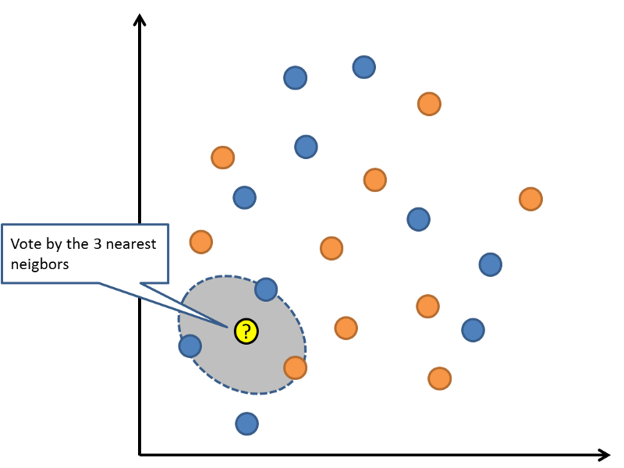
K-NEAREST NEIGHBORS
Predictions are made for a new data point by searching through the entire training set for the K most similar instances.
KNN require a lot of memory or space to store all of the data

Slide 9
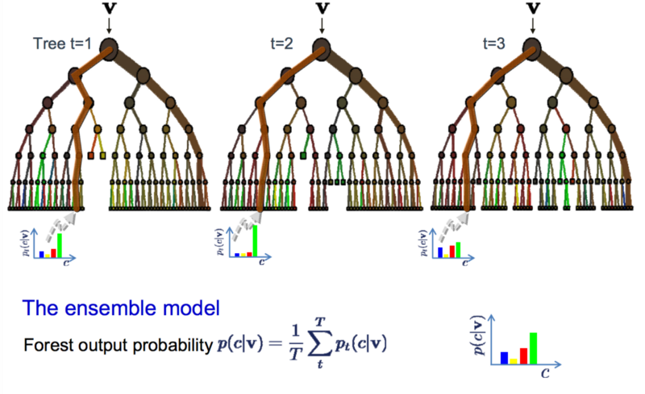
BAGGING--RANDOM FOREST
Random Forest is one of the most popular and most powerful machine learning algorithms.
It is a type of ensemble machine learning algorithm called Bootstrap Aggregation or bagging.
Random forest is a combination of many decision trees

Slide 10
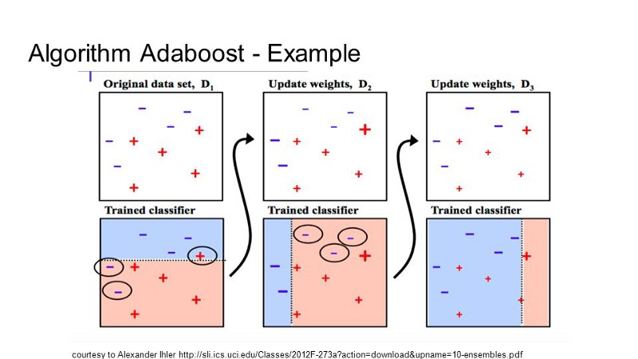
BOOSTING--ADABOOST
Boosting is an ensemble technique that attempts to create a strong classifier from a number of weak classifiers
This is done by building a model from the training data, then creating a second model that attempts to correct the errors from the first model.

Slide 11
OTHER POPULAR BOOSTING TECHNIQUES
Ligthgbm
Xgboost
Catboost e.t.c

Slide 12
SOME UNSUPERVISED LEARNING ALGORITHM
K-MEANS
PCA (PRINCIPAL COMPONENT ANALYSIS

Slide 13
EVALUATING MODEL PERFORMANCE
Regression problems
Mean Absolute Error
Mean Squared Error
R-squared error
RMSE (Root Mean Squared Error)
e.t.c
Can all implemented in Scikit-Learn (A python machine learning package)
Classification problems
Accuracy
Classification Report
Confusion Matrix
Can also be implemented in Scikit-Learn (A python machine learning package)

Slide 14
END OF SESSION

